Slide 1
NCI SemNet Project ​
Update Meeting​ for NLM
March 30, 2023
Samvit Solutions

Slide 2
Attendees & Agenda Topics
Attendees: Warzel Denise, Duran Deborah, Taylor Robin, McAuliffe Matthew, Lu Zhengwu, Hastak Smita, Ver Hoef Wendy, Kevin Armengol, Syed Sofia, Olga Vovk (other people?? Smita)
Start recording!!!!!
Agenda:
Review the entire pipeline for organizing Project 5 COVID CDEs by their semantic meaning (UMLS and NCIt CUIs and NCIt concept hierarchy).
Demo the work as time permits
Reminder:
  We are applying the Plan B Iteration 2a variables
    CDE Name (minus stop word)
    Question Text (minus stop word)

Slide 3
Objective of today’s meeting
To present the end to end semi-automated pipeline of providing semantics grouping of Project 5 COVID CDEs under NCI thesaurus concepts.

Slide 4
Overall Status of the Project
Project ending end of mid-April 2023
We are writing the final report
The proof-of-concept was a collaboration between NCI CBIIT team, NLM MetaMap Team and BRICS Team
All project artifacts in MS Teams and on CBIIT GitHub

Slide 5
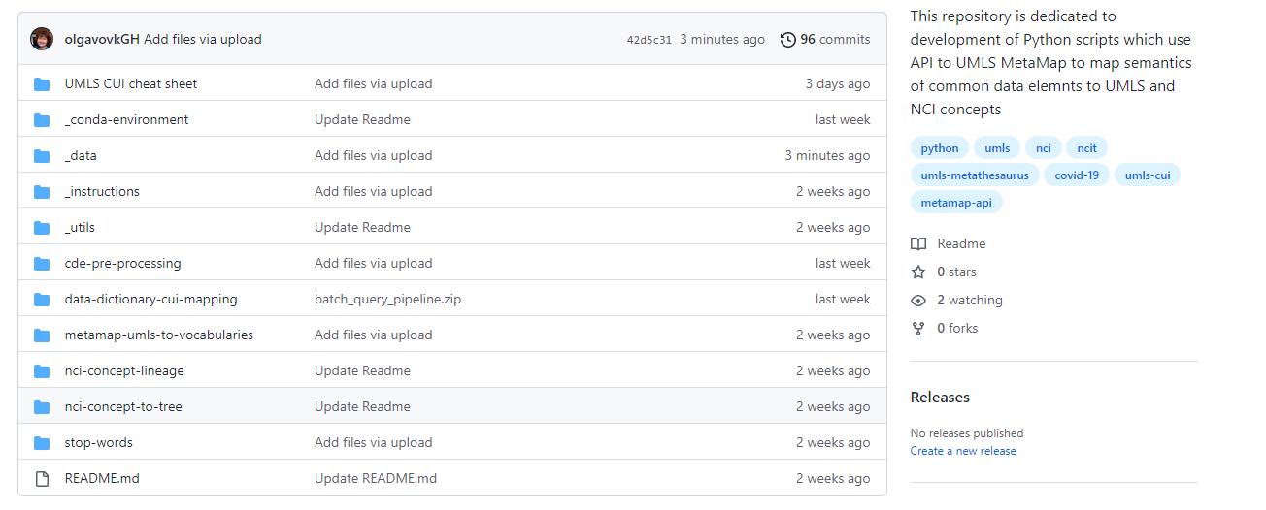
  Proof of Concept Python Pipeline on CBIIT GitHub
The latest and greatest Python scripts are available on CBIIT/UMLS-MetaMap-API-Scripts GitHub
COVID CDE mappings and tree
Pipeline: Python scripts

Slide 6
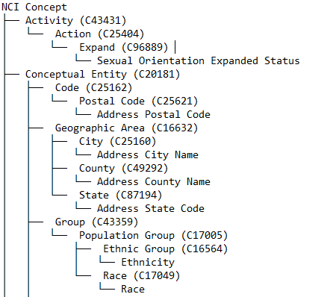

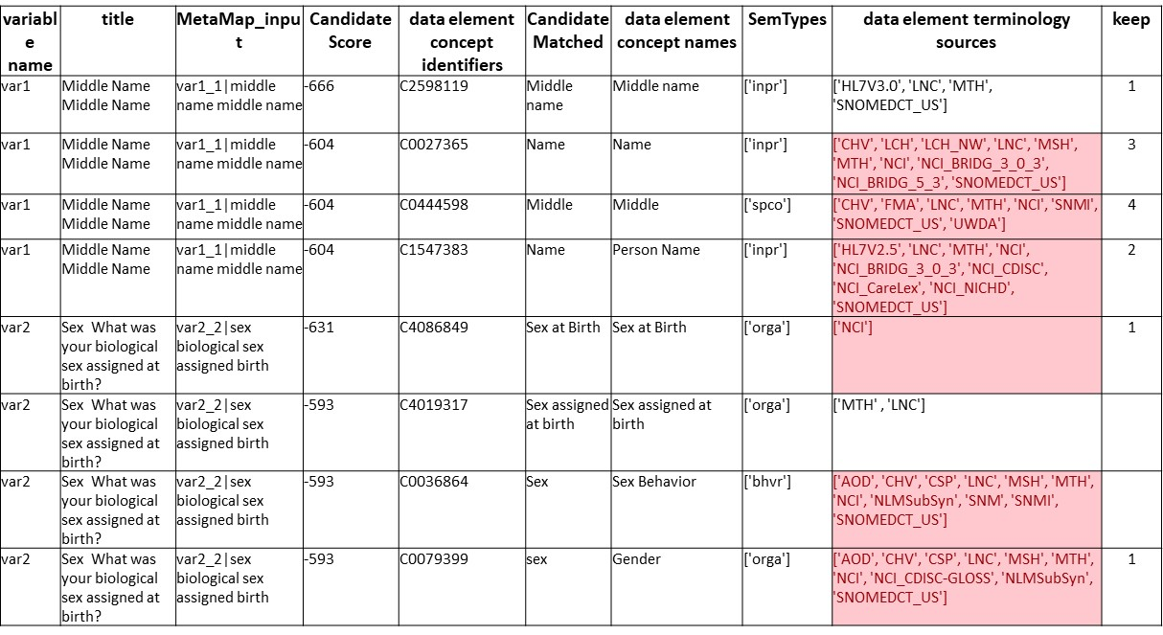

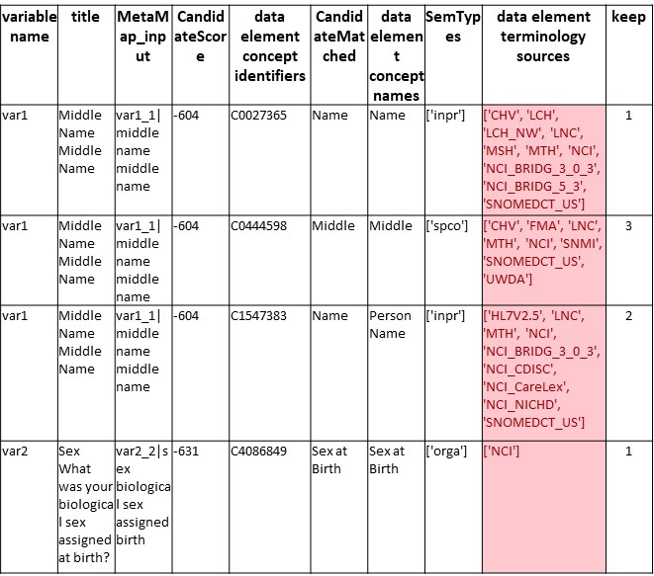

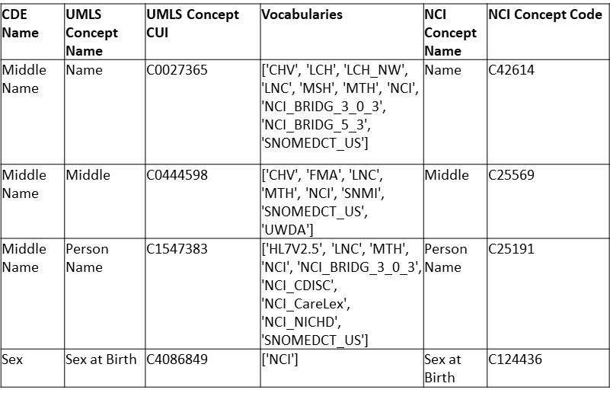







Pipeline architecture
CDEs presented
in the NCIt tree
MetaMap
MetaMap
output file
retrieves CUIs
Submits an excel
File with data
elements
Candidates
Submit to MetaMap
Python script
Researcher
File prepared for
MetaMap
Python script
Curated MetaMap
Output file
Python Script
NCIt Excel
download
Uses UMLS CUIs & Retrieves corresponding NCIt Codes
UMLS Metathesaurus

Slide 7
CDE attributes to UMLS CUIs -> NCI CUIs -> NCI Concept Tree
Input: Project 5 COVID CDE 2 attributes: CDE Name and Question text
Python
MS Excel Formula
Curation
Curation
Curation
API to MetaMap scripts
UMLS to NCIt script
NCIt concept lineage retrieval from EVS
Python
NCI concept lineage tree

Slide 8
Software and hardware requirements
The Python scripts were developed and tested using:
Python 3.9
Anaconda Navigator (Anaconda 3)
Python modules needed to run the scripts include:
  Pandas; Numpy; OS; treelib; Tree(from treelib); pathlib; Path(from Path); shutil; glob; tkinter; filedialog(from tkinter); json; pprint; openpyxl; requests.
Anaconda environment: download the environment files to use in Anaconda, to make your life easier.
To use the MetaMap Python API requires to build on your local the Python-based API created for the Indexing Initiative Scheduler facility (NLM) used to provide users with the ability to programmatically submit jobs to the Scheduler Batch and Interactive facilities.
Hardware:
The scripts were tested on standard NIH Dell laptops. (nothing special)
Other requirements:
Have an access the UMLS: request a UMLS Metathesaurus License and API key

Slide 9
  Proof of concept - Python pipeline on CBIIT GitHub
0. Pre-processing step: addressing the issue that all CDE repositories have slightly different templates
  From Project 5 COVID CDE spreadsheet take 2 columns: CDE Name and Question Text. Save as a CSV.
  Run through cde-pre-processing.py
  Save the output as a CSV file
  1. API to MetaMap set of scripts (batch_query_pipeline.py ): load in a data dictionary and map CDE semantics to UMLS CUIs using MetaMap API from NLM
  Set up the configuration file (can be done once)
  Specifically enter user name and API key (can be done once)
  Take the output from step #0c, run through batch_query_pipeline.py
  Review the output, select the UMLS CUIs best match CDE semantics
  Format and save the output as .xls file
  2. UMLS to NCIt (umls-to-vocabularies.py): returning NCIt CUIs for UMLS CUIs
  Take the output from the step #1e.
  Run thorough umls-to-vocabularies.py
  Save the output as a CSV file
  3. Retrieve NCIt concept lineage
  Take the output from #2c and
  Apply the MS Excel formula from “NCIt concept lineage retrieval from EVS file.xlsx”
  Save the output file as a CSV file.
  4. Build NCIt concept tree for each CDE (nci-concept-to-tree.py )
  Take an output from 3c
  Run through nci-concept-to-tree.py
  Review and save the output as a TXT file

Slide 10





  Proof of concept Python pipeline on CBIIT GitHub
0
cde-pre-processing.zip – transforms 2 column CSV file with Project 5 COVID CDE attributes: “CDE Name” and “Question Text” to feed to MetaMap. This step can be omitted
batch_query_pipeline.zip – API to MetaMap set of scripts, created and supported by BRICS. The main GitHub for developing these scripts is Kevin A. GitHub repository. The package allows to load in a data dictionary and map CDE semantics to UMLS CUIs using MetaMap API from NLM
umls-to-vocabularies.py – the script which hits API to UMLS and returns NCIt concept for each given UMLS concept for each CDE
nci-concept-lineage – contains “NCIt concept lineage retrieval form EVS file.xlsx” file which uses a formula applied to December 2022 NCI Thesaurus download from EVS
nci-concept-to-tree.zip - generates a tree like structure (as a TXT file) where NCIt concepts and CUIs are presented as branches and common data elements as leaves
1
2
3
4
CBIIT GitHub: https://github.com/CBIIT/UMLS-MetaMap-API-Scripts

Slide 11
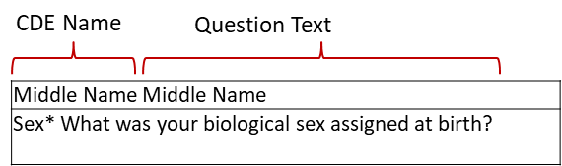
Process outline: API to MetaMap to map CDE attributes to UMLS CUIs
(batch_query_pipeline.py)
For each CDEs from Project 5 COVID CDEs spreadsheet batch_query_pipeline.py script:
Takes a CSV file with CDE attributes from step #0
Removes stop words and punctuation marks. Stop words on GitHub.
Saves the CDE attributes file in tab delimited format, where each row represents a single CDE.
Runs the file from #3 through API to MetaMap using the settings,
specified in “config_metamap_api.yml” file (next slide).
5. Outputs the MetaMap mapping as an MS Excel file (next slide).
batch_query_pipeline.py
var1_1|middle name middle name
var2_2|sex biological sex assigned birth

Slide 12
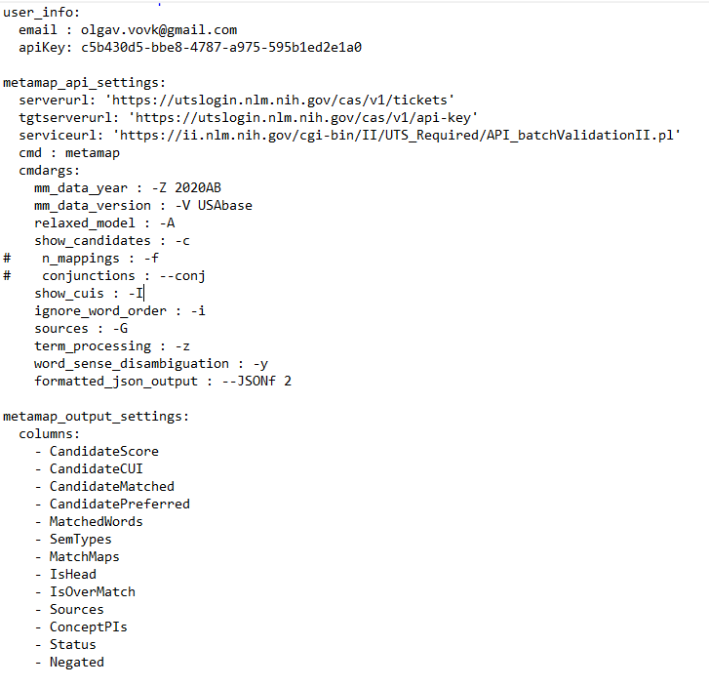
Process outline: API to MetaMap to map CDE attributes to UMLS CUIs
(configuration file)
Use config_metamap_api.yml to configure
1. Access to UMLS Metathesaurus
2. MetaMap API settings
3. MetaMap output settings
This can be done once.
config_metamap_api.yaml
MetaMap FAQ https://lhncbc.nlm.nih.gov/ii/tools/MetaMap/Docs/MM_FAQ.pdf
https://lhncbc.nlm.nih.gov/ii/tools/MetaMap/Docs/MM12_XML_Info.html

Slide 13
Process outline: manually review MetaMap output
Use this column to select which concepts to keep for mapping
Manually review MetaMap output.
variable name | title | MetaMap_input | Candidate Score | data element concept identifiers | CandidateMatched | data element concept names | SemTypes | data element terminology sources (‘NCI’ highlighted in red) | keep
var1 | Middle Name Middle Name | var1_1|middle name middle name | -666 | C2598119 | Middle name | Middle name | ['inpr'] | ['HL7V3.0', 'LNC', 'MTH', 'SNOMEDCT_US'] | 1
var1 | Middle Name Middle Name | var1_1|middle name middle name | -604 | C0027365 | Name | Name | ['inpr'] | ['CHV', 'LCH', 'LCH_NW', 'LNC', 'MSH', 'MTH', 'NCI', 'NCI_BRIDG_3_0_3', 'NCI_BRIDG_5_3', 'SNOMEDCT_US'] | 3
var1 | Middle Name Middle Name | var1_1|middle name middle name | -604 | C0444598 | Middle | Middle | ['spco'] | ['CHV', 'FMA', 'LNC', 'MTH', 'NCI', 'SNMI', 'SNOMEDCT_US', 'UWDA'] | 4
var1 | Middle Name Middle Name | var1_1|middle name middle name | -604 | C1547383 | Name | Person Name | ['inpr'] | ['HL7V2.5', 'LNC', 'MTH', 'NCI', 'NCI_BRIDG_3_0_3', 'NCI_CDISC', 'NCI_CareLex', 'NCI_NICHD', 'SNOMEDCT_US'] | 2
var2 | Sex What was your biological sex assigned at birth? | var2_2|sex biological sex assigned birth | -631 | C4086849 | Sex at Birth | Sex at Birth | ['orga'] | ['NCI'] | 1
var2 | Sex What was your biological sex assigned at birth? | var2_2|sex biological sex assigned birth | -593 | C4019317 | Sex assigned at birth | Sex assigned at birth | ['orga'] | ['MTH' , 'LNC']
var2 | Sex What was your biological sex assigned at birth? | var2_2|sex biological sex assigned birth | -593 | C0036864 | Sex | Sex Behavior | ['bhvr'] | ['AOD', 'CHV', 'CSP', 'LNC', 'MSH', 'MTH', 'NCI', 'NLMSubSyn', 'SNM', 'SNMI', 'SNOMEDCT_US']
var2 | Sex What was your biological sex assigned at birth? | var2_2|sex biological sex assigned birth | -593 | C0079399 | sex | Gender | ['orga'] | ['AOD', 'CHV', 'CSP', 'LNC', 'MSH', 'MTH', 'NCI', 'NCI_CDISC-GLOSS', 'NLMSubSyn', 'SNOMEDCT_US'] | 1
When reviewing the list of concepts, consider checking with project concepts’ “cheat sheet”. Available on GitHub.
Structure of MetaMap’s JSON output: https://lhncbc.nlm.nih.gov/ii/tools/MetaMap/Docs/JSON.pdf
UMLS Semantic types cheat sheet https://lhncbc.nlm.nih.gov/ii/tools/MetaMap/Docs/SemanticTypes_2018AB.txt

Slide 14
Process outline: save curated MetaMap output
Saving curated MetaMap output in a format so it can be fed to UMLS to Vocabularies script
Curated MetaMap output file, .xls
Table_1.xls file to be used by umls-to-vocabularies.py
variable name | title | MetaMap_input | CandidateScore | data element concept identifiers | CandidateMatched | data element concept names | SemTypes | data element terminology sources | keep
var1 | Middle Name Middle Name | var1_1|middle name middle name | -604 | C0027365 | Name | Name | ['inpr'] | ['CHV', 'LCH', 'LCH_NW', 'LNC', 'MSH', 'MTH', 'NCI', 'NCI_BRIDG_3_0_3', 'NCI_BRIDG_5_3', 'SNOMEDCT_US'] | 1
var1 | Middle Name Middle Name | var1_1|middle name middle name | -604 | C0444598 | Middle | Middle | ['spco'] | ['CHV', 'FMA', 'LNC', 'MTH', 'NCI', 'SNMI', 'SNOMEDCT_US', 'UWDA'] | 3
var1 | Middle Name Middle Name | var1_1|middle name middle name | -604 | C1547383 | Name | Person Name | ['inpr'] | ['HL7V2.5', 'LNC', 'MTH', 'NCI', 'NCI_BRIDG_3_0_3', 'NCI_CDISC', 'NCI_CareLex', 'NCI_NICHD', 'SNOMEDCT_US'] | 2
var2 | Sex What was your biological sex assigned at birth? | var2_2|sex biological sex assigned birth | -631 | C4086849 | Sex at Birth | Sex at Birth | ['orga'] | ['NCI'] | 1
CDE Name | UMLS Concept Name | UMLS Concept CUI | Vocabularies
Middle Name | Name | C0027365 | ['CHV', 'LCH', 'LCH_NW', 'LNC', 'MSH', 'MTH', 'NCI', 'NCI_BRIDG_3_0_3', 'NCI_BRIDG_5_3', 'SNOMEDCT_US']
Middle Name | Middle | C0444598 | ['CHV', 'FMA', 'LNC', 'MTH', 'NCI', 'SNMI', 'SNOMEDCT_US', 'UWDA']
Middle Name | Person Name | C1547383 | ['HL7V2.5', 'LNC', 'MTH', 'NCI', 'NCI_BRIDG_3_0_3', 'NCI_CDISC', 'NCI_CareLex', 'NCI_NICHD', 'SNOMEDCT_US']
Sex | Sex at Birth | C4086849 | ['NCI']

Slide 15
Process outline: API to MetaMap - notes
Note: to restrict MetaMap to return only those UMLS concepts which are present in NCI vocabularies, one can use the settings defined in config_metamap_api.yaml file for batch_query_pipeline.py and specify: “restrict to sources: -R, NCI”
(work in progress).
Note: to address the issue that different CDE repositories have slightly different CDE templates, one can specify the list of columns in a given template in de.yaml configuration file (work in progress).
Note: one can also specify which CDE attributes (or columns in the CDE spreadsheet) use for mapping in de.yaml configuration file (work in progress).
MetaMap’s Exclude and Restrict to UMLS Sources: https://lhncbc.nlm.nih.gov/ii/tools/MetaMap/Docs/Sources.pdf

Slide 16
Process outline: UMLS to NCIt
umls-to-vocabularies.py – the script which hits the UMLS API and returns NCIt concept for each given UMLS concept for each CDE.
We have moved now from UMLS to NCIt.
Input: Table_1.xls file
Output: Final_Table.csv file
CDE Name | UMLS Concept Name | UMLS Concept CUI | Vocabularies
Middle Name | Name | C0027365 | ['CHV', 'LCH', 'LCH_NW', 'LNC', 'MSH', 'MTH', 'NCI', 'NCI_BRIDG_3_0_3', 'NCI_BRIDG_5_3', 'SNOMEDCT_US']
Middle Name | Middle | C0444598 | ['CHV', 'FMA', 'LNC', 'MTH', 'NCI', 'SNMI', 'SNOMEDCT_US', 'UWDA']
Middle Name | Person Name | C1547383 | ['HL7V2.5', 'LNC', 'MTH', 'NCI', 'NCI_BRIDG_3_0_3', 'NCI_CDISC', 'NCI_CareLex', 'NCI_NICHD', 'SNOMEDCT_US']
Sex | Sex at Birth | C4086849 | ['NCI']
CDE Name | UMLS Concept Name | UMLS Concept CUI | Vocabularies | NCI Concept Name | NCI Concept Code
Middle Name | Name | C0027365 | ['CHV', 'LCH', 'LCH_NW', 'LNC', 'MSH', 'MTH', 'NCI', 'NCI_BRIDG_3_0_3', 'NCI_BRIDG_5_3', 'SNOMEDCT_US'] | Name | C42614
Middle Name | Middle | C0444598 | ['CHV', 'FMA', 'LNC', 'MTH', 'NCI', 'SNMI', 'SNOMEDCT_US', 'UWDA'] | Middle | C25569
Middle Name | Person Name | C1547383 | ['HL7V2.5', 'LNC', 'MTH', 'NCI', 'NCI_BRIDG_3_0_3', 'NCI_CDISC', 'NCI_CareLex', 'NCI_NICHD', 'SNOMEDCT_US'] | Person Name | C25191
Sex | Sex at Birth | C4086849 | ['NCI'] | Sex at Birth | C124436

Slide 17
Process outline: for each CDE retrieve NCIt concept lineage
nci-concept-lineage – contains “NCIt concept lineage retrieval from EVS file.xlsx” file which uses a lookup formula to identify a parent-child hierarchy from root to leaf.
(Note: the formula was applied to December 2022 NCI Thesaurus download from EVS. NCI publishes the updated version every month. Each NCI concept can have multiple parents, the formula picks the first parent.)
Output from umls-to-vocabularies.py: Final_Table.csv file
MS Excel formula
CDE Name | UMLS Concept Name | UMLS Concept CUI | Vocabularies | NCI Concept Name | NCI Concept Code | NCIt Concept Lineage
Middle Name | Name | C0027365 | ['CHV', 'LCH', 'LCH_NW', 'LNC', 'MSH', 'MTH', 'NCI', 'NCI_BRIDG_3_0_3', 'NCI_BRIDG_5_3', 'SNOMEDCT_US'] | Name | C42614 | Conceptual Entity (C20181) > Name (C42614)
Middle Name | Middle | C0444598 | ['CHV', 'FMA', 'LNC', 'MTH', 'NCI', 'SNMI', 'SNOMEDCT_US', 'UWDA'] | Middle | C25569 | Property or Attribute (C20189) > Qualifier (C41009) > Spatial Qualifier (C73706) > Middle (C25569)
Middle Name | Person Name | C1547383 | ['HL7V2.5', 'LNC', 'MTH', 'NCI', 'NCI_BRIDG_3_0_3', 'NCI_CDISC', 'NCI_CareLex', 'NCI_NICHD', 'SNOMEDCT_US'] | Person Name | C25191 | Conceptual Entity (C20181) > Name (C42614) > Person Name (C25191)
Sex | Sex at Birth | C4086849 | ['NCI'] | Sex at Birth | C124436 | Property or Attribute (C20189) > Person/Individual Attribute (C171087) > Personal Attribute (C19332) > Sex (C28421) > Sex at Birth (C124436)
NCIt EVS downloads: https://evs.nci.nih.gov/ftp1/

Slide 18
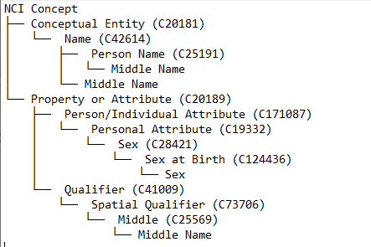
Process outline: build NCIt concept tree for each CDE
nci-concept-to-tree.py - generates a tree like structure (as a TXT file) from the output file from step 3, where NCIt concepts and CUIs are presented as branches and common data elements as leaves
Middle Name CDE
Sex CDE
Middle Name CDE

Slide 19
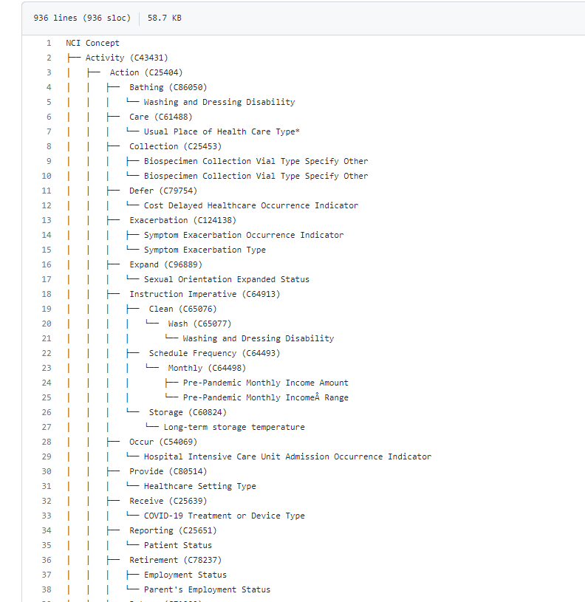
Process outline: aggregated NCIt concept tree for Project 5 COVID CDEs
Available on CBIIT GitHub
Project 5 COVID CDEs Aggregated Tree 2023-03-30.txt
Note:
NCIt concepts are branches and they have C codes in parenthesis.
CDEs are leaves in this tree and they do not have NCIt codes.
That is how one can differentiate one from another.
This tree shows where Project 5 COVID CDEs fall semantically in NCIt concept hierarchy.
NCIt concepts
CDE

Slide 20
Process outline: aggregated NCIt concept tree for Project 5 COVID CDEs
Some numbers where Project 5 COVID CDEs fall semantically in NCIt concept hierarchy:
Highest level NCIt concept name and CUI | Count of concept lineage branches under the highest/high level concept | Comment
Activity (C43431) | 45 | as of 2023-03-28
Activity (C43431) > Action (C25404) | 21 | as of 2023-03-28
Biological Process (C17828) | 4 | as of 2023-03-28
Conceptual Entity (C20181) | 79 | as of 2023-03-28
Disease, Disorder or Finding (C7057) | 20 | as of 2023-03-28
Drug, Food, Chemical or Biomedical Material (C1908) | 4 | as of 2023-03-28
Gene Product (C26548) | 1 | as of 2023-03-28
Molecular Abnormality (C3910) | 1 | as of 2023-03-28
Organism (C14250) | 2 | as of 2023-03-28
Property or Attribute (C20189) | 85 | as of 2023-03-28
 | 262
Available on CBIIT GitHub:
COVID CDE Domains with NCI with concept lineage.xlsx
Project 5 COVID CDEs Aggregated Tree 2023-03-30.txt

Slide 21
Caveats
API to MetaMap
Currently we use API to MetaMap and access the UMLS server located and supported by NLM.
That means:
  we do not have a control on this server and don’t know 1) when it is down, or 2) gets updated.
  using MetaMap and direct search in UMLS sometimes give slightly different results.
  we might also get slightly different results from one update to another.
  Possible solution for would be to have and maintain a local UMLS server.
NCIt concept hierarchy
The MS Excel formula used to retrieve NCIt concept hierarchy was applied to December 2022 NCI Thesaurus download from EVS.
As it appears each NCI concept can have multiple parents, the formula picks the first parent.
NCI publishes the updated version every month. We might want to address that when we decide to develop a Python script to retrieve the NCIt concept hierarchy.

Slide 22
Future work
Scripts
Address the issue that all CDE repositories have slightly different templates
  Make de.yaml configuration file to address various CDE templates (not very relevant now)
  This will let us to incorporate step #0 into the main “batch_query_pipeline” script (not very relevant now)
2. Add the ability to specify UMLS vocabularies and to return vocabulary specific CUIs
  That will let us to get rid of step 2 and incorporate it into the main “batch_query_pipeline” script
3. Add semantic rules to the main script, such as:
  Filtering by specified semantic types
  Filtering by MetaMap score
  Filtering by specific vocabularies
  Use of n-grams
  4. Add more messages to the user during the execution of the scripts.
  5. Pythonize the use of MS Excel formula used to retrieve NCIt concept lineage. API to EVS.
  Data:
  We need to test the scripts on the bigger body of CDEs, preferably from different projects to fine tune them and to make sure they produce desired results.

Slide 23
Team Acknowledgements
NCI CBIIT:
Fed. Leads: Denise Warzel, Deborah Duran
Leidos TPM: Zhengwu Lu
Samvit Solutions:
Olga Vovk
Wendy Ver Hoef
Sofia Syed
Hastak Smita
BRICS team:
Fed. Lead: Matthew McAuliffe
Sapient: Kevin Armengol
NLM MetaMap: Francois Lang

Slide 24
Questions
Does that approach look feasible?
If, Yes, what do you think would be our next steps?

Slide 25
Back up slides

Slide 26
What to be shown for NLM?
Show: end to end proof of concepts
We worked 1.5 years, tried different approaches
Show the final approach Show a hierarchy
Show a slide with technical components
Show a demo if possible
Ask NLM: what they need from us? Is that approach feasible?

Slide 27
Materials for this call
Examples for NLM 2023-03-30.xls on MS Teams

